Slide 1

Intro to Computer Vision
With Python

Slide 2
Content
What is CV
OpenCV
Read, write
Manipulate image
What data format?
Detection/trigger
Color detection
Contour
Machine Learning libraries
Mediapipe
Communicate with other program
Serial

Slide 3
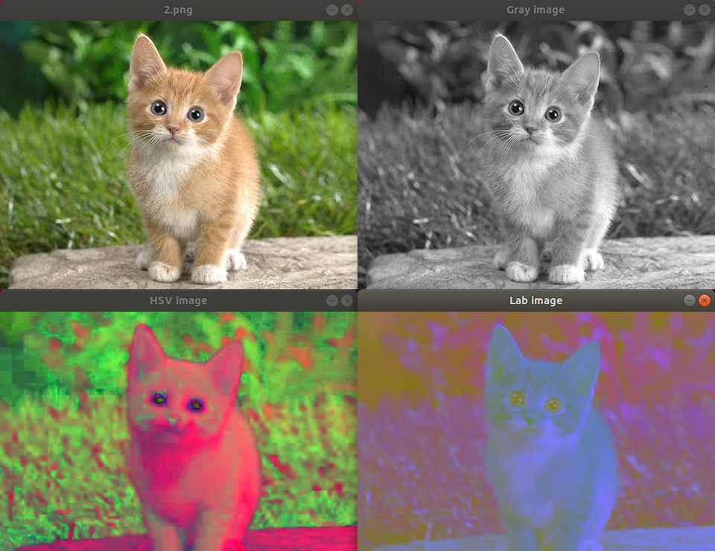
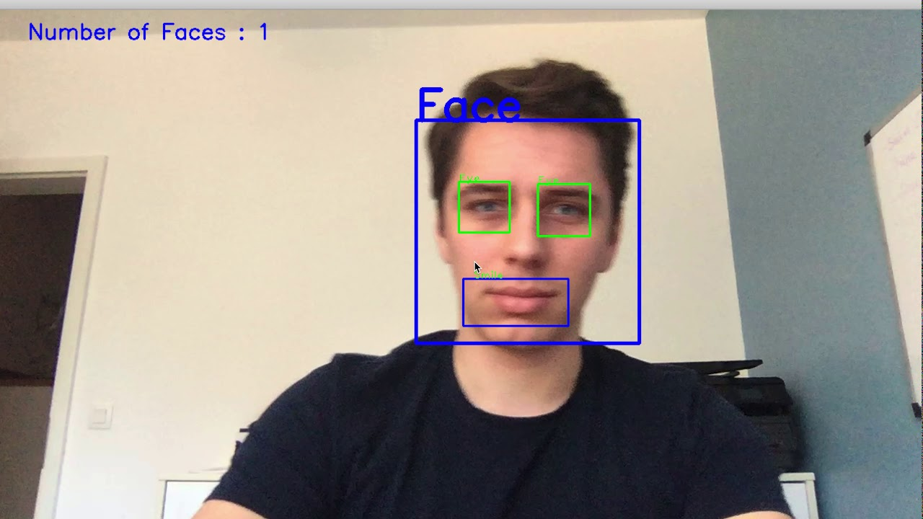
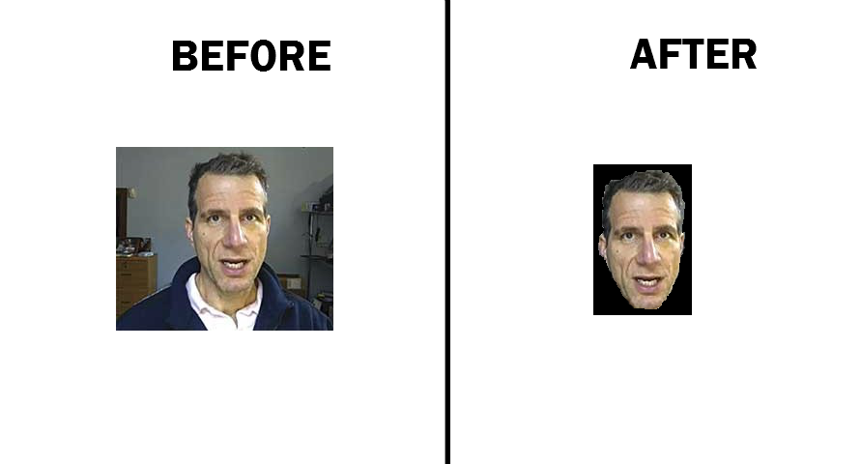
What is OpenCV?
OpenCV provides a real-time optimized Computer Vision library, tools, and hardware
-Basically a convenient method to pre-process large quantities of images (e.g. cropping/resizing/inverting colors/highlighting regions of interest) before CV training is performed on the images.
Crop/Resize Images
Separating Color Channels
Highlighting Regions of Interest

Slide 4
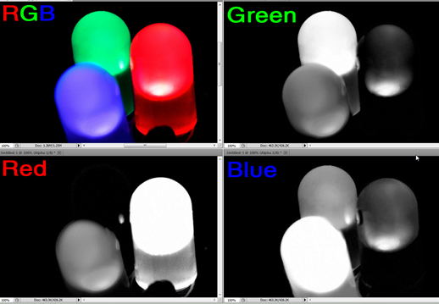
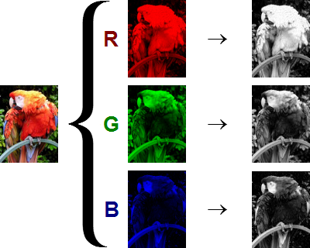
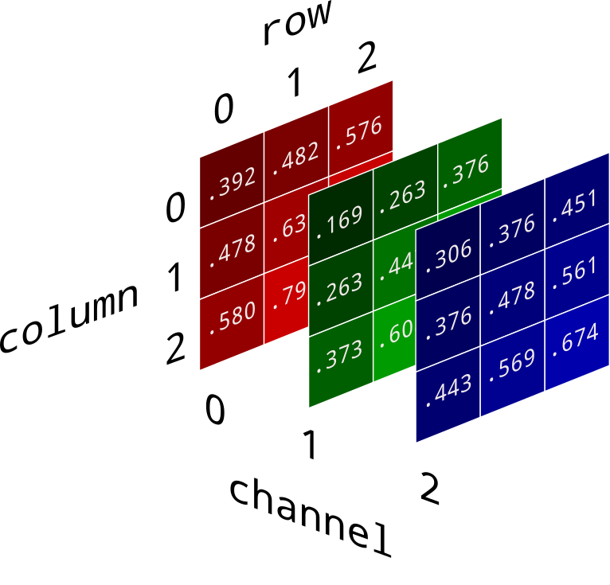
RGB Channel Separation
How hoomans see the world
How your eyes see the world
How computers see the world
How image data is stored in computers

Slide 5
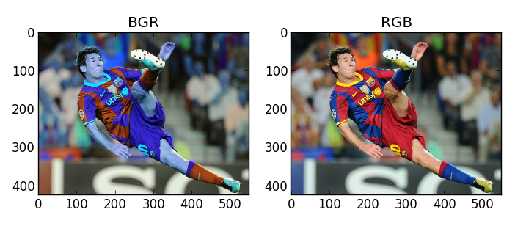
OpenCV uses BGR, not RGB (which is kinda weird, just live with it)

Slide 6
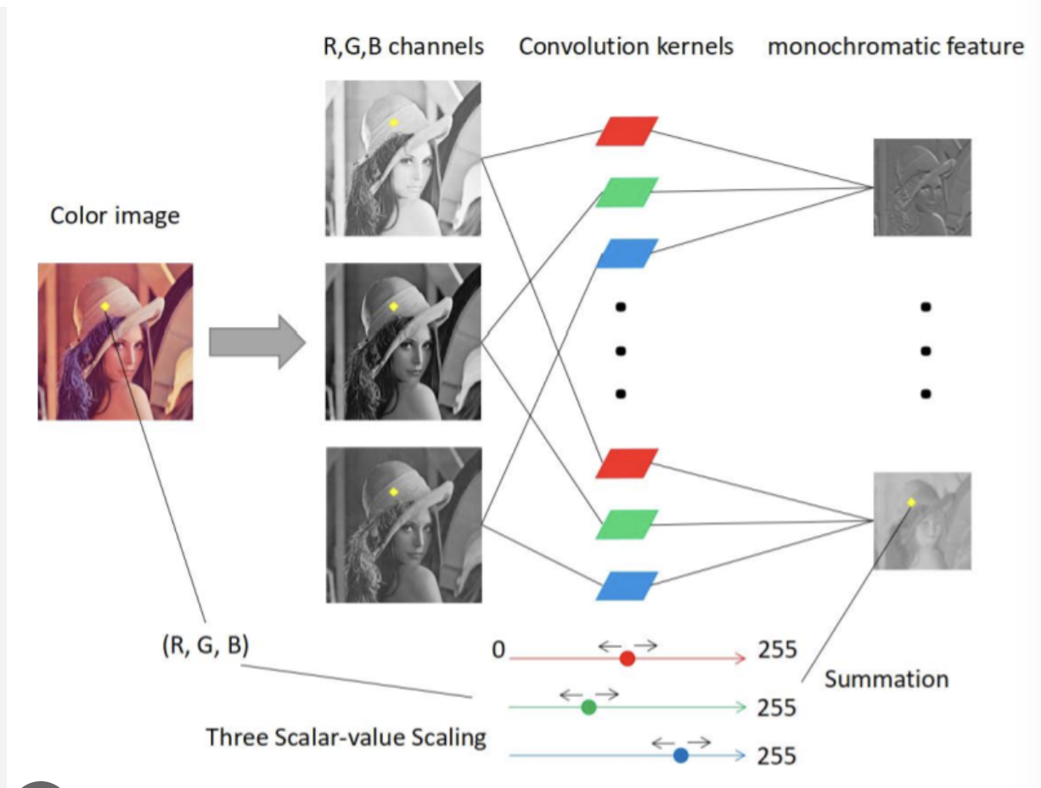
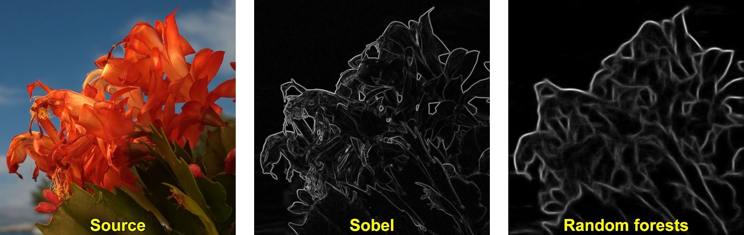
Contour/Edge Detection
-Contour/Edge detection forms the foundational building block for almost all modern CV techniques
-More advanced techniques use RGB colors/better algorithms to form more complex edge detection (color gradient/sharp corners etc)
Different edge detection algorithms yield different results
Overview of how RGB edge detection works

Slide 7
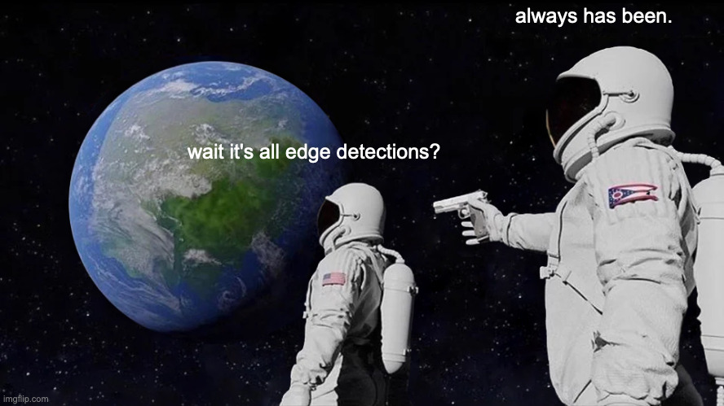
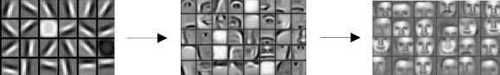
Sneak Peek: How advanced models work (will be covered in MLDA’s CNN workshop)
-Everything can be reduced into a set of detections
-Edge detection -> Feature detection -> Object detection etc
Edge Detection
Feature Detection
Object Detection

Slide 8
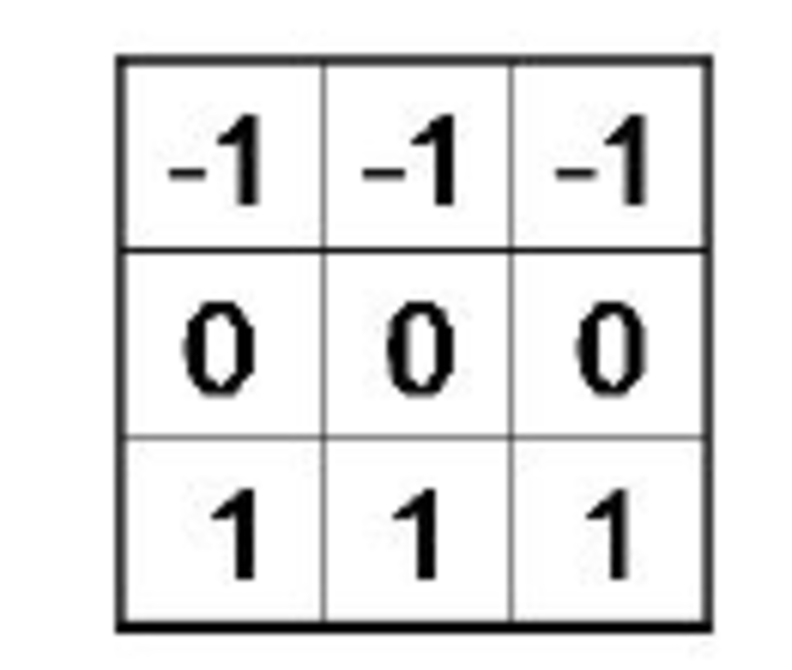
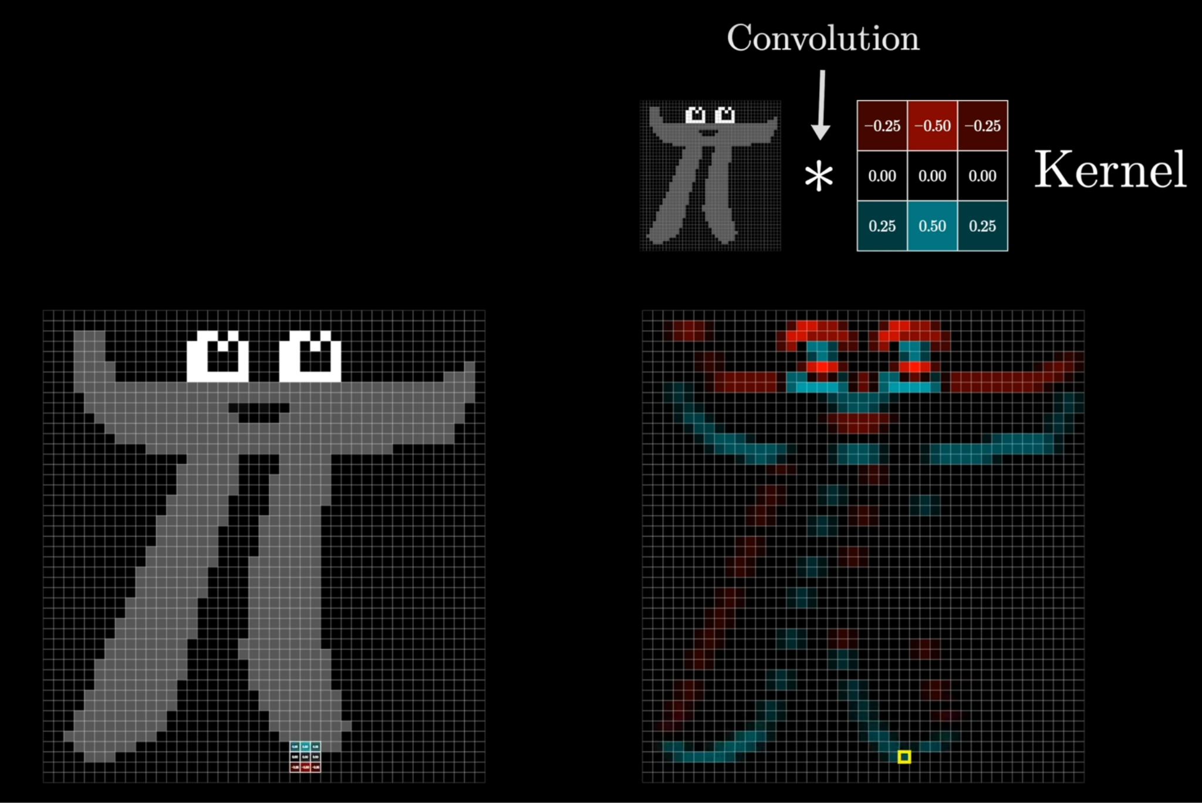
So how does Edge Detection actually work?
Horizontal Edge Detection
3Blue1Brown vid on convolution (go watch, it’s goooood!)

Slide 9
ACTUAL CODE YAY
-Go to Google Colab
-Open the file that we have sent you (shld be named xxxxxxx.ipynb)

Slide 10
Machine Learning Libraries
Let’s face it… we are not ML researchers. But that doesn’t mean we cannot “stand on the shoulder of giants”
MediaPipe:
Demo: https://mediapipe-studio.webapps.google.com/home
Installation: https://developers.google.com/mediapipe/solutions/setup_python
`pip install mediapipe`
Documentation: https://developers.google.com/mediapipe/solutions/guide
Demo / Code along (code already available)

Slide 11
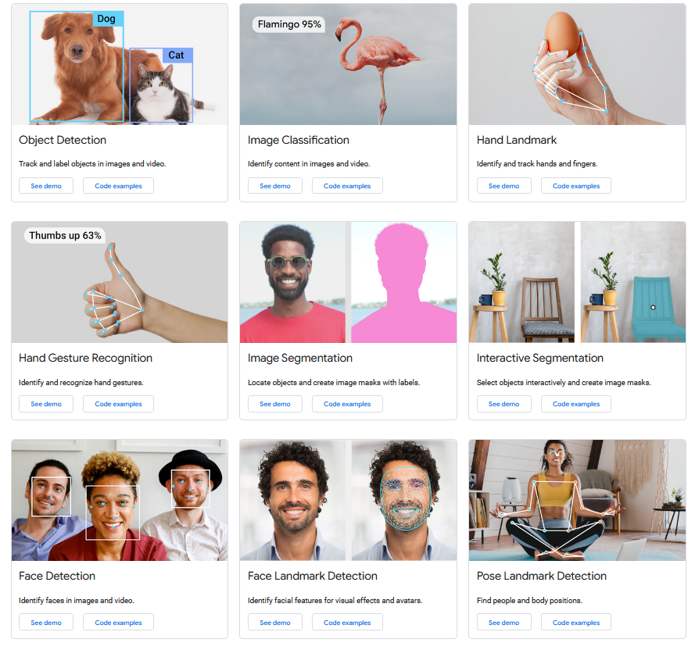

Slide 12
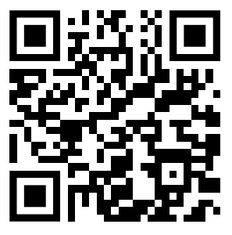
MLDA Github Mediapipe Repository

Slide 13
Communicate with other programs
Now that your python code can detect interesting things using camera, how to use that detection signal to do anything useful?
Serial communication
`pip install pyserial`
Demo / Code along (code already available)

